Slide 1
Machine Learning –
Course Design
Lecturer: Hao Xiong

Slide 2
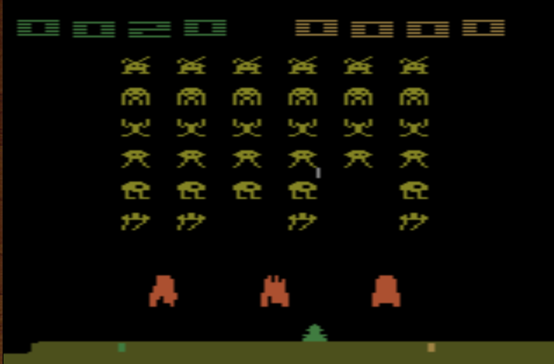
Recall - Space invader
Termination: all the aliens are killed, or your spaceship is destroyed.
Score (reward)
Kill the aliens
shield
fire
Notes:
Can I play it???
====
Widely studies:
Gym: https://gym.openai.com/
Universe: https://openai.com/blog/universe/
Machine learns to play video games as human players
What machine observes is pixels
Machine learns to take proper action itself

Slide 3
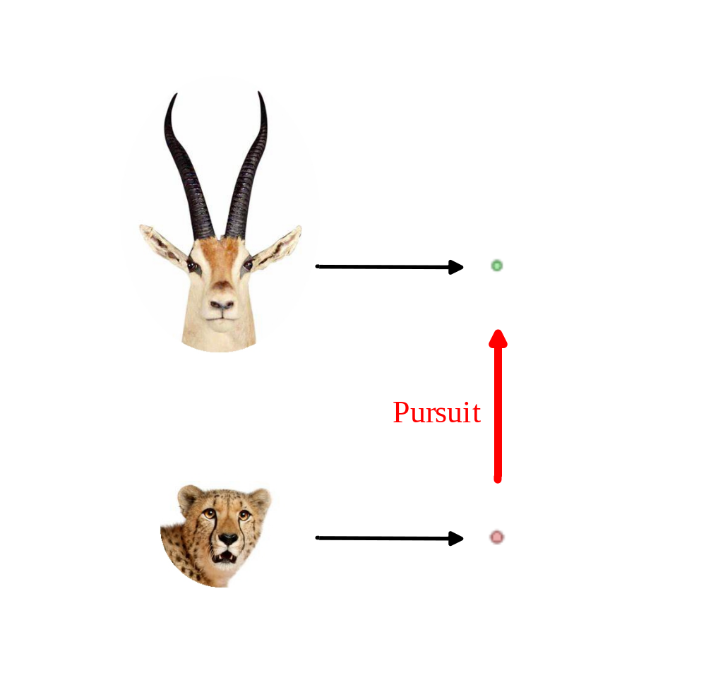
Course Design – Save the Prey
Acceleration
Prey
Predator
Notes:
Can I play it???
====
Widely studies:
Gym: https://gym.openai.com/
Universe: https://openai.com/blog/universe/
Machine learns to play video games as human players
What machine observes is pixels
Machine learns to take proper action itself

Slide 4
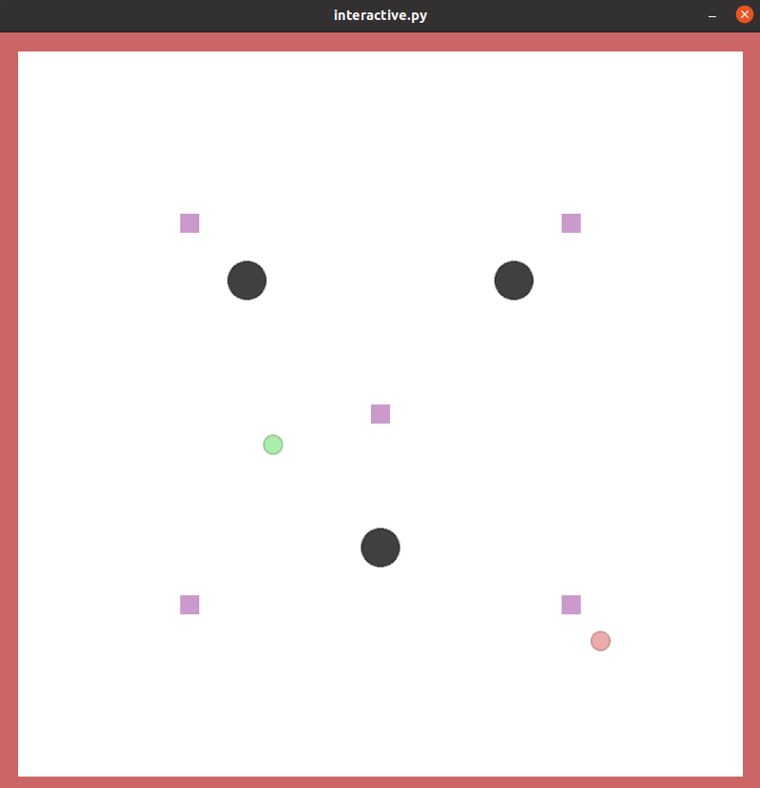
Course Design – Save the Prey
Termination: the prey reaches a shelter or gets caught.
Obstacle
Shelter
Notes:
Can I play it???
====
Widely studies:
Gym: https://gym.openai.com/
Universe: https://openai.com/blog/universe/
Machine learns to play video games as human players
What machine observes is pixels
Machine learns to take proper action itself

Slide 5
Course Design – Save the Prey
Input – Image of the environment
Output – Bounded acceleration of the prey in 2D space
Targets – 1) Avoid obstacles; 2) Avoid the predator; and 3) Reach a shelter
Initial state – The prey, predator, and shelter have random locations
Notes:
Can I play it???
====
Widely studies:
Gym: https://gym.openai.com/
Universe: https://openai.com/blog/universe/
Machine learns to play video games as human players
What machine observes is pixels
Machine learns to take proper action itself

Slide 6
Rules
Apply at least one Machine Learning technique.
Learn a model that can control the prey to reach a shelter safely.

Slide 7
Rules
The total score for the course design is 100 points.
A group can achieve 80 points, if a learned model can input the image of the environment and control the prey to 1) avoid obstacles; 2) avoid the predator; and 3) reach the shelter.
A group can achieve 10 to 20 points, if an interesting presentation and creative ideas are provided.

Slide 8
Rules
If a model needs to input the state of the environment, you will lose 30 points.
If a model fails to avoid obstacles, you will lose 20 points.
If a model fails to avoid the predator, you will lose 10 points.
If a model fails to reach the shelter, you will lose 20 points.

